Slide 1

Workshop Part II
Representing Data with Excel

Slide 2
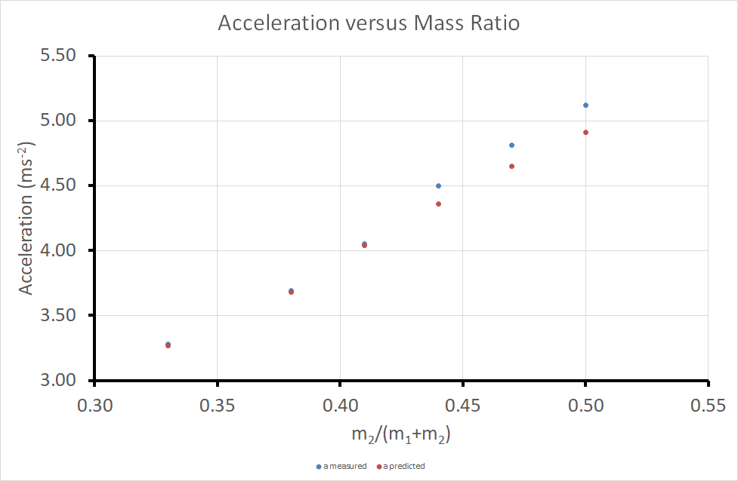
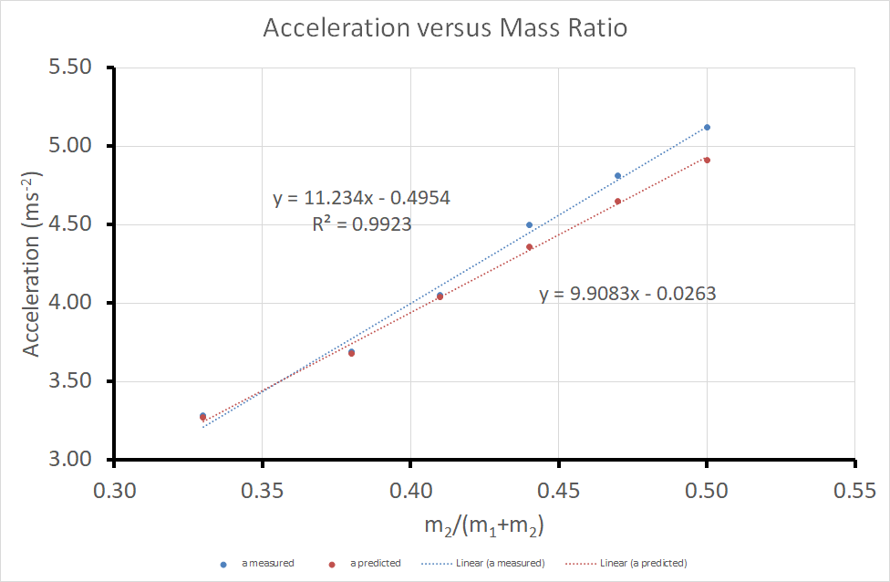
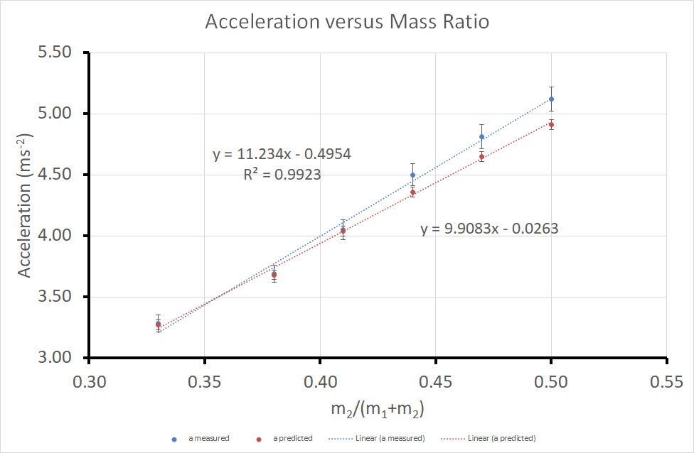
Aims of Today’s Workshop (Part II)
To produce a high quality graph from experimental data using Excel.
To add linear trendlines to a graph using Excel.
To add uncertainty bars to a graph using Excel.

Slide 3
Aims of Today’s Workshop (Part II)
To calculate the uncertainty in Trendline values
To compare results using a graph and come to an evidence-based conclusion.

Slide 4
Introduction (Part II)
When producing an experimental graph it is useful to consider the following checklist
Title | Trendline
Data Spread | Equation and R²
Axis Labelled (including units) | Predicted and Measured Results
Appropriate Variables | Uncertainty “Error” Bars
We will cover how to produce a graph with all of these elements in todays computer lab.

Slide 5
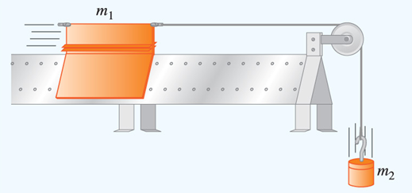
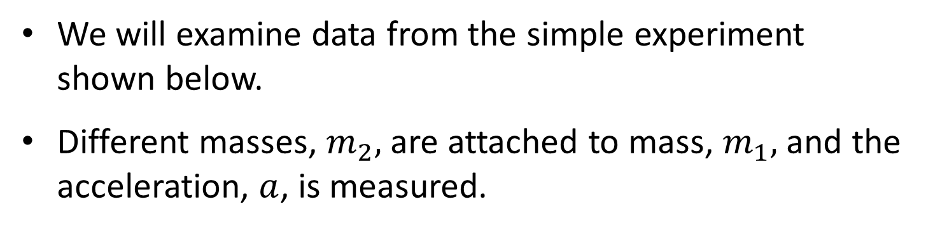
Introduction (Part II)
We will examine data from the simple experiment shown below.
Different masses, $m_{2},$ are attached to mass, $m_{1},$ and the acceleration, $a$, is measured.

Slide 6
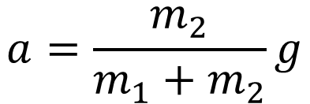
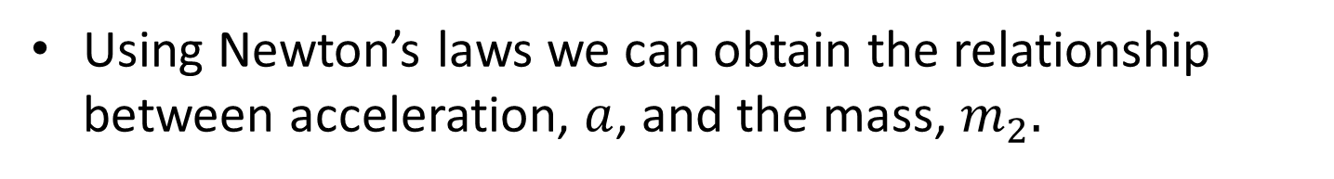
Introduction (Part II)
Using Newton’s laws we can obtain the relationship between acceleration, $a$, and the mass, $m_{2}.$
$$a=\frac{m_{2}}{m_{1}+m_{2}}g$$
Where m₁ (100 g) is the mass of the vehicle.
m₂ is the mass of the falling weight.
a is the acceleration.
g is the gravitational constant.

Slide 7
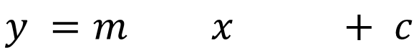
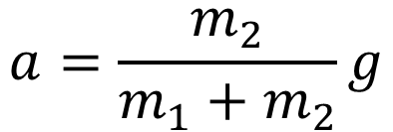
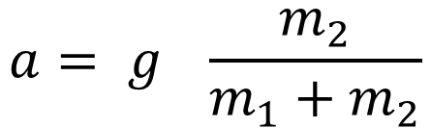
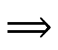
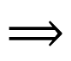
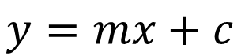
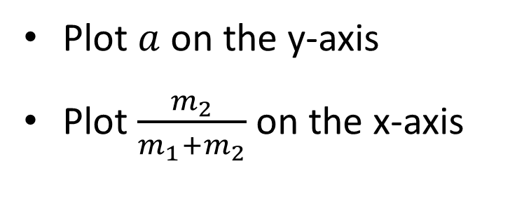
Introduction (Part II)
We then compare our equation to the standard equation for a straight line
$$a=\frac{m_{2}}{m_{1}+m_{2}}g$$
$$a= g \frac{m_{2}}{m_{1}+m_{2}}$$
$$⟹$$
$$y=mx+c$$
$$⟹$$
$$y =m x + c$$
Plot $a$ on the y-axis
Plot $\frac{m_{2}}{m_{1}+m_{2}}$ on the x-axis

Slide 8
Today’s Task (Part II)
Download the Microsoft Excel spreadsheet “Spreadsheet 2XXXXXXXX” from Moodle.
The first thing to do is to rename the spreadsheet, to do this load up the directory where you have saved the file.

Slide 9
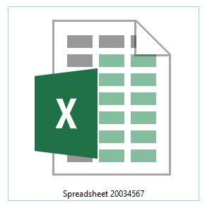
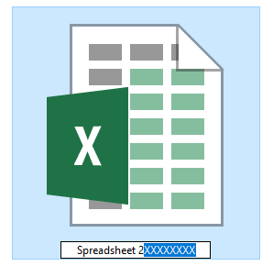
Today’s Task (Part II)
Select “2XXXXXXXX” and replace it with your student ID number.
Your task is to produce a single graph in the Excel file by following the instructions in the PowerPoint and to answer the questions in the Excel file.

Slide 10
Today’s Task (Part II)
You will learn how to represent data graphically using scatter plots, trendlines, error bars and how to determine the uncertainty in the trendline values.
Producing a good graph
Task One | Task Two | Task Three
Producing a Good Graph | Linear Trendlines (Line of best fit) | Uncertainty Bars
Analysing your graph
Task Four | Task Five
Determine uncertainty in gradient and intercept | Comparing predicted and measured results.

Slide 11
Task 1
Representing Data with Excel:
Producing a Good Graph

Slide 12
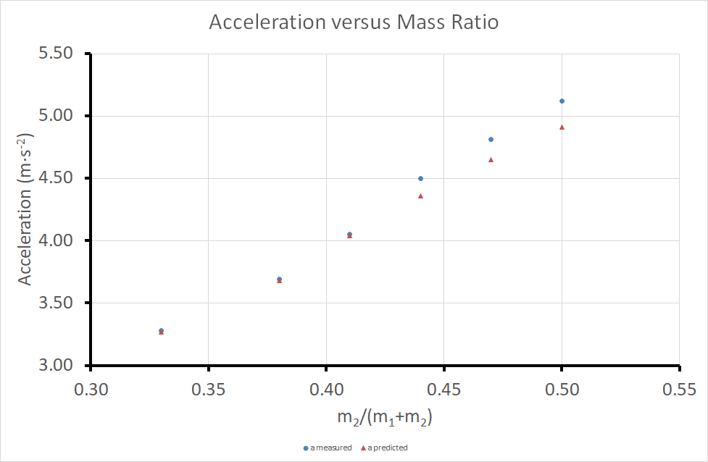
Task One – Producing a Good Graph
Lets first look at how to produce a good graph

Slide 13
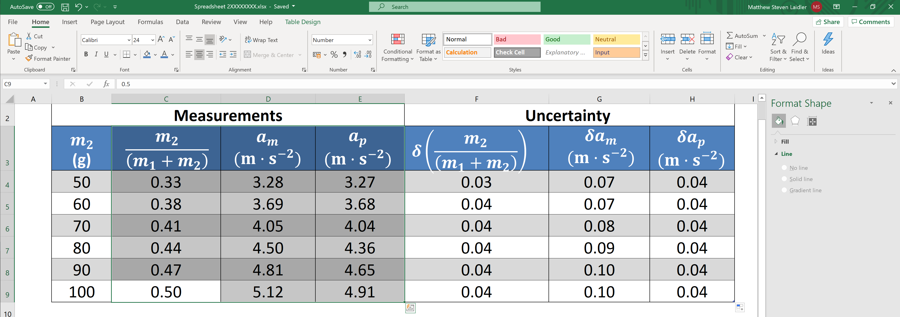
Highlight the data you wish to include (both x values and the measured and predicted y values)
Task One – Producing a Good Graph

Slide 14
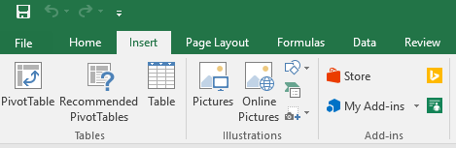
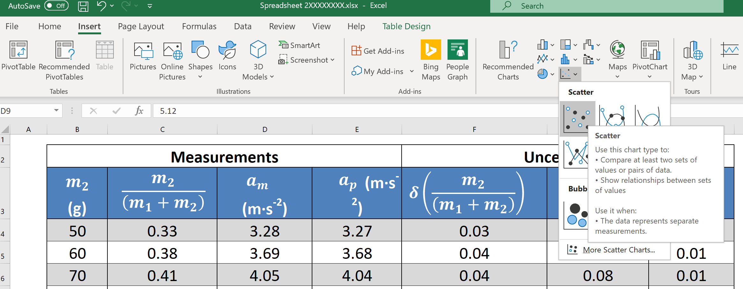
Select the Insert tab from the top menu
Task One – Producing a Good Graph
Then choose Scatter

Slide 15
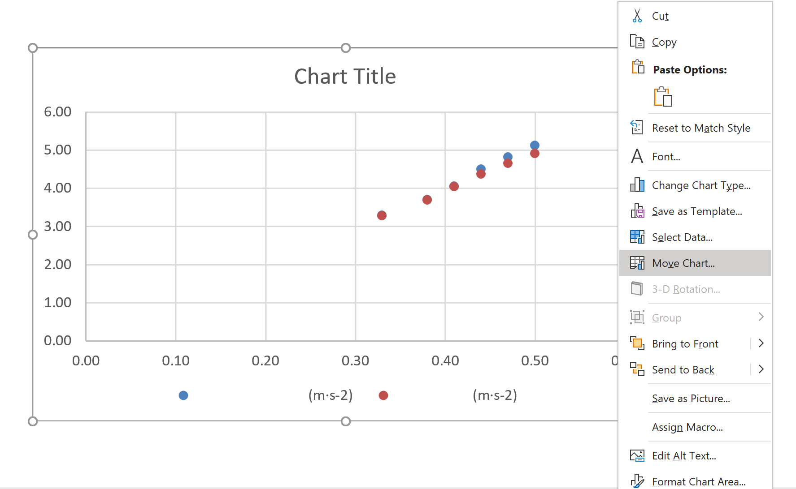
Next click on the chart, then right click and select Move Chart in the menu.
Task One – Producing a Good Graph

Slide 16
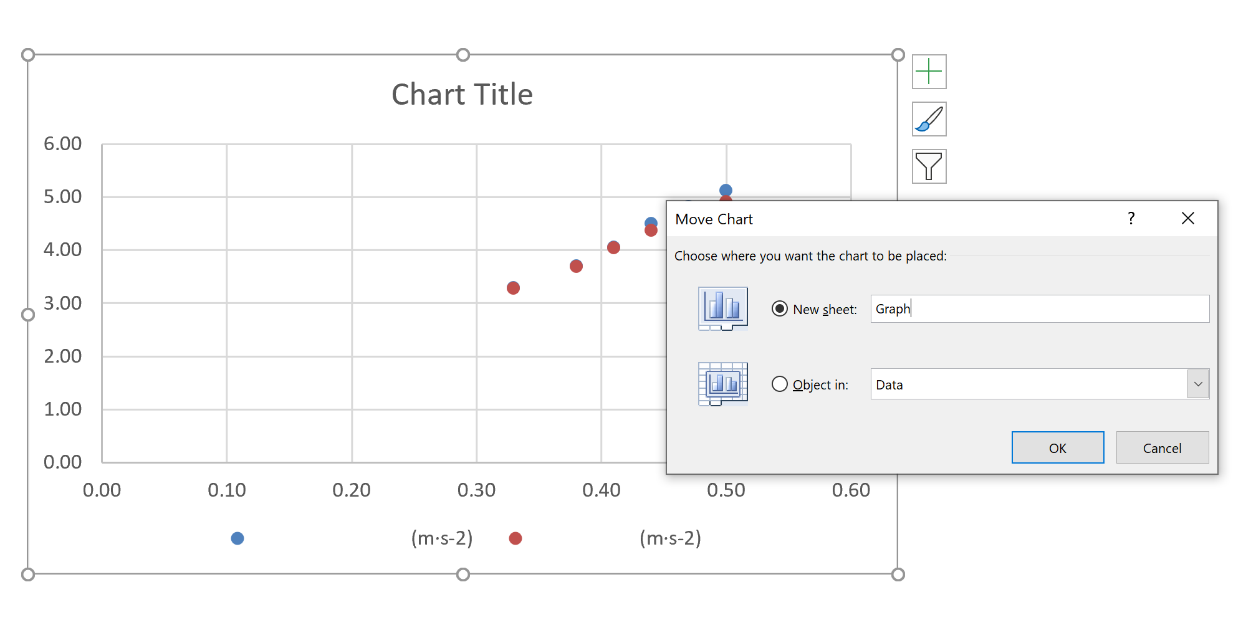
In the move chart window select New sheet. Then change the name to “Graph” and click on Ok.
Task One – Producing a Good Graph

Slide 17
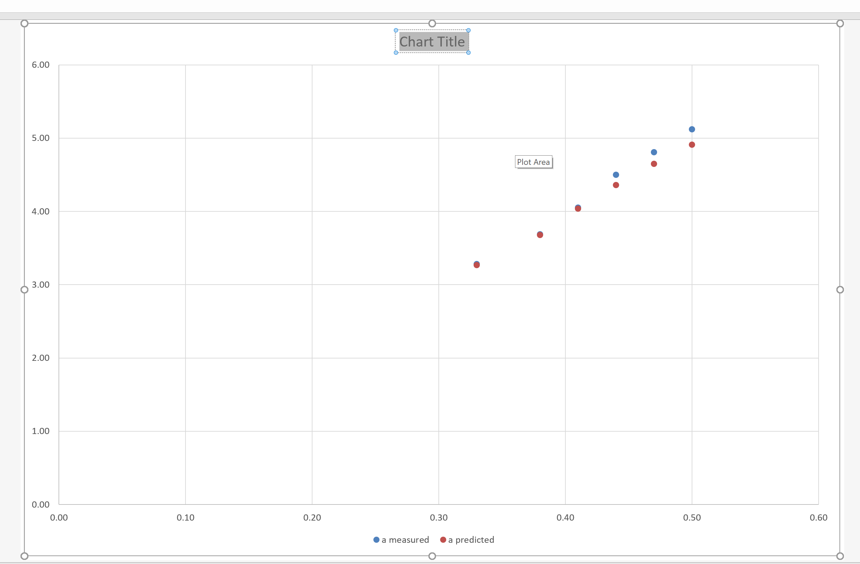
Highlight “Chart Title”, delete this text and type in the new the title of the graph;
Task One – Producing a Good Graph
“Acceleration versus Mass Ratio”

Slide 18
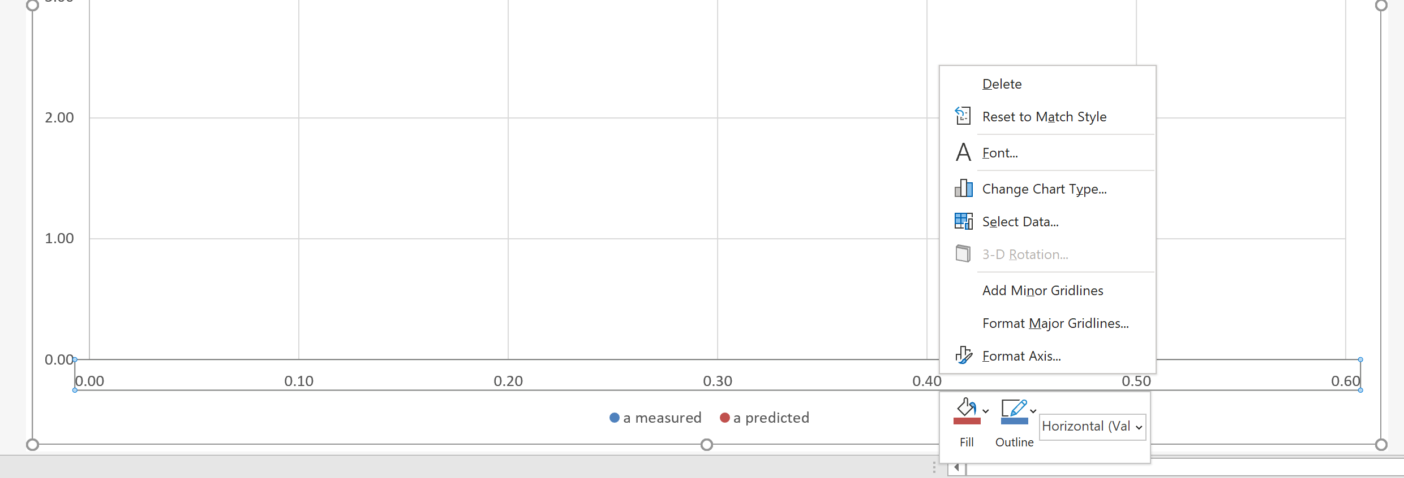
Left click any number on the x-axis, and then right click, selecting format axis from the menu.
Task One – Producing a Good Graph

Slide 19
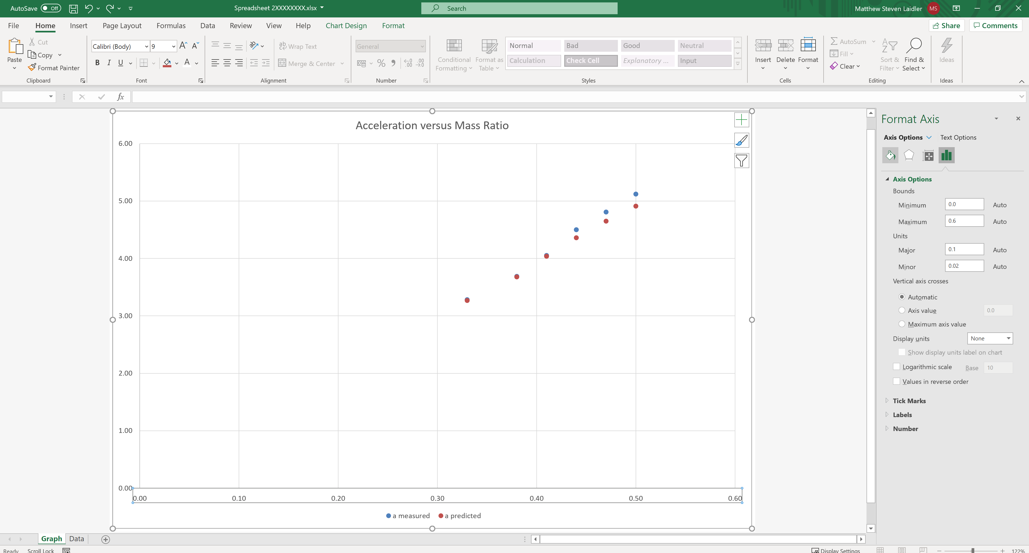
Click on Fill & Line in the Format Axis menu.
Task One – Producing a Good Graph

Slide 20
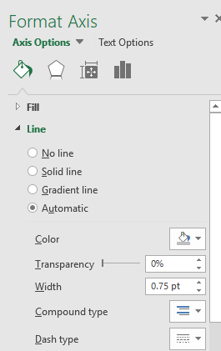
Select Line and set the line colour to black and adjust the Width to 3 and. Repeat the process for the y-axis.
Task One – Producing a Good Graph

Slide 21
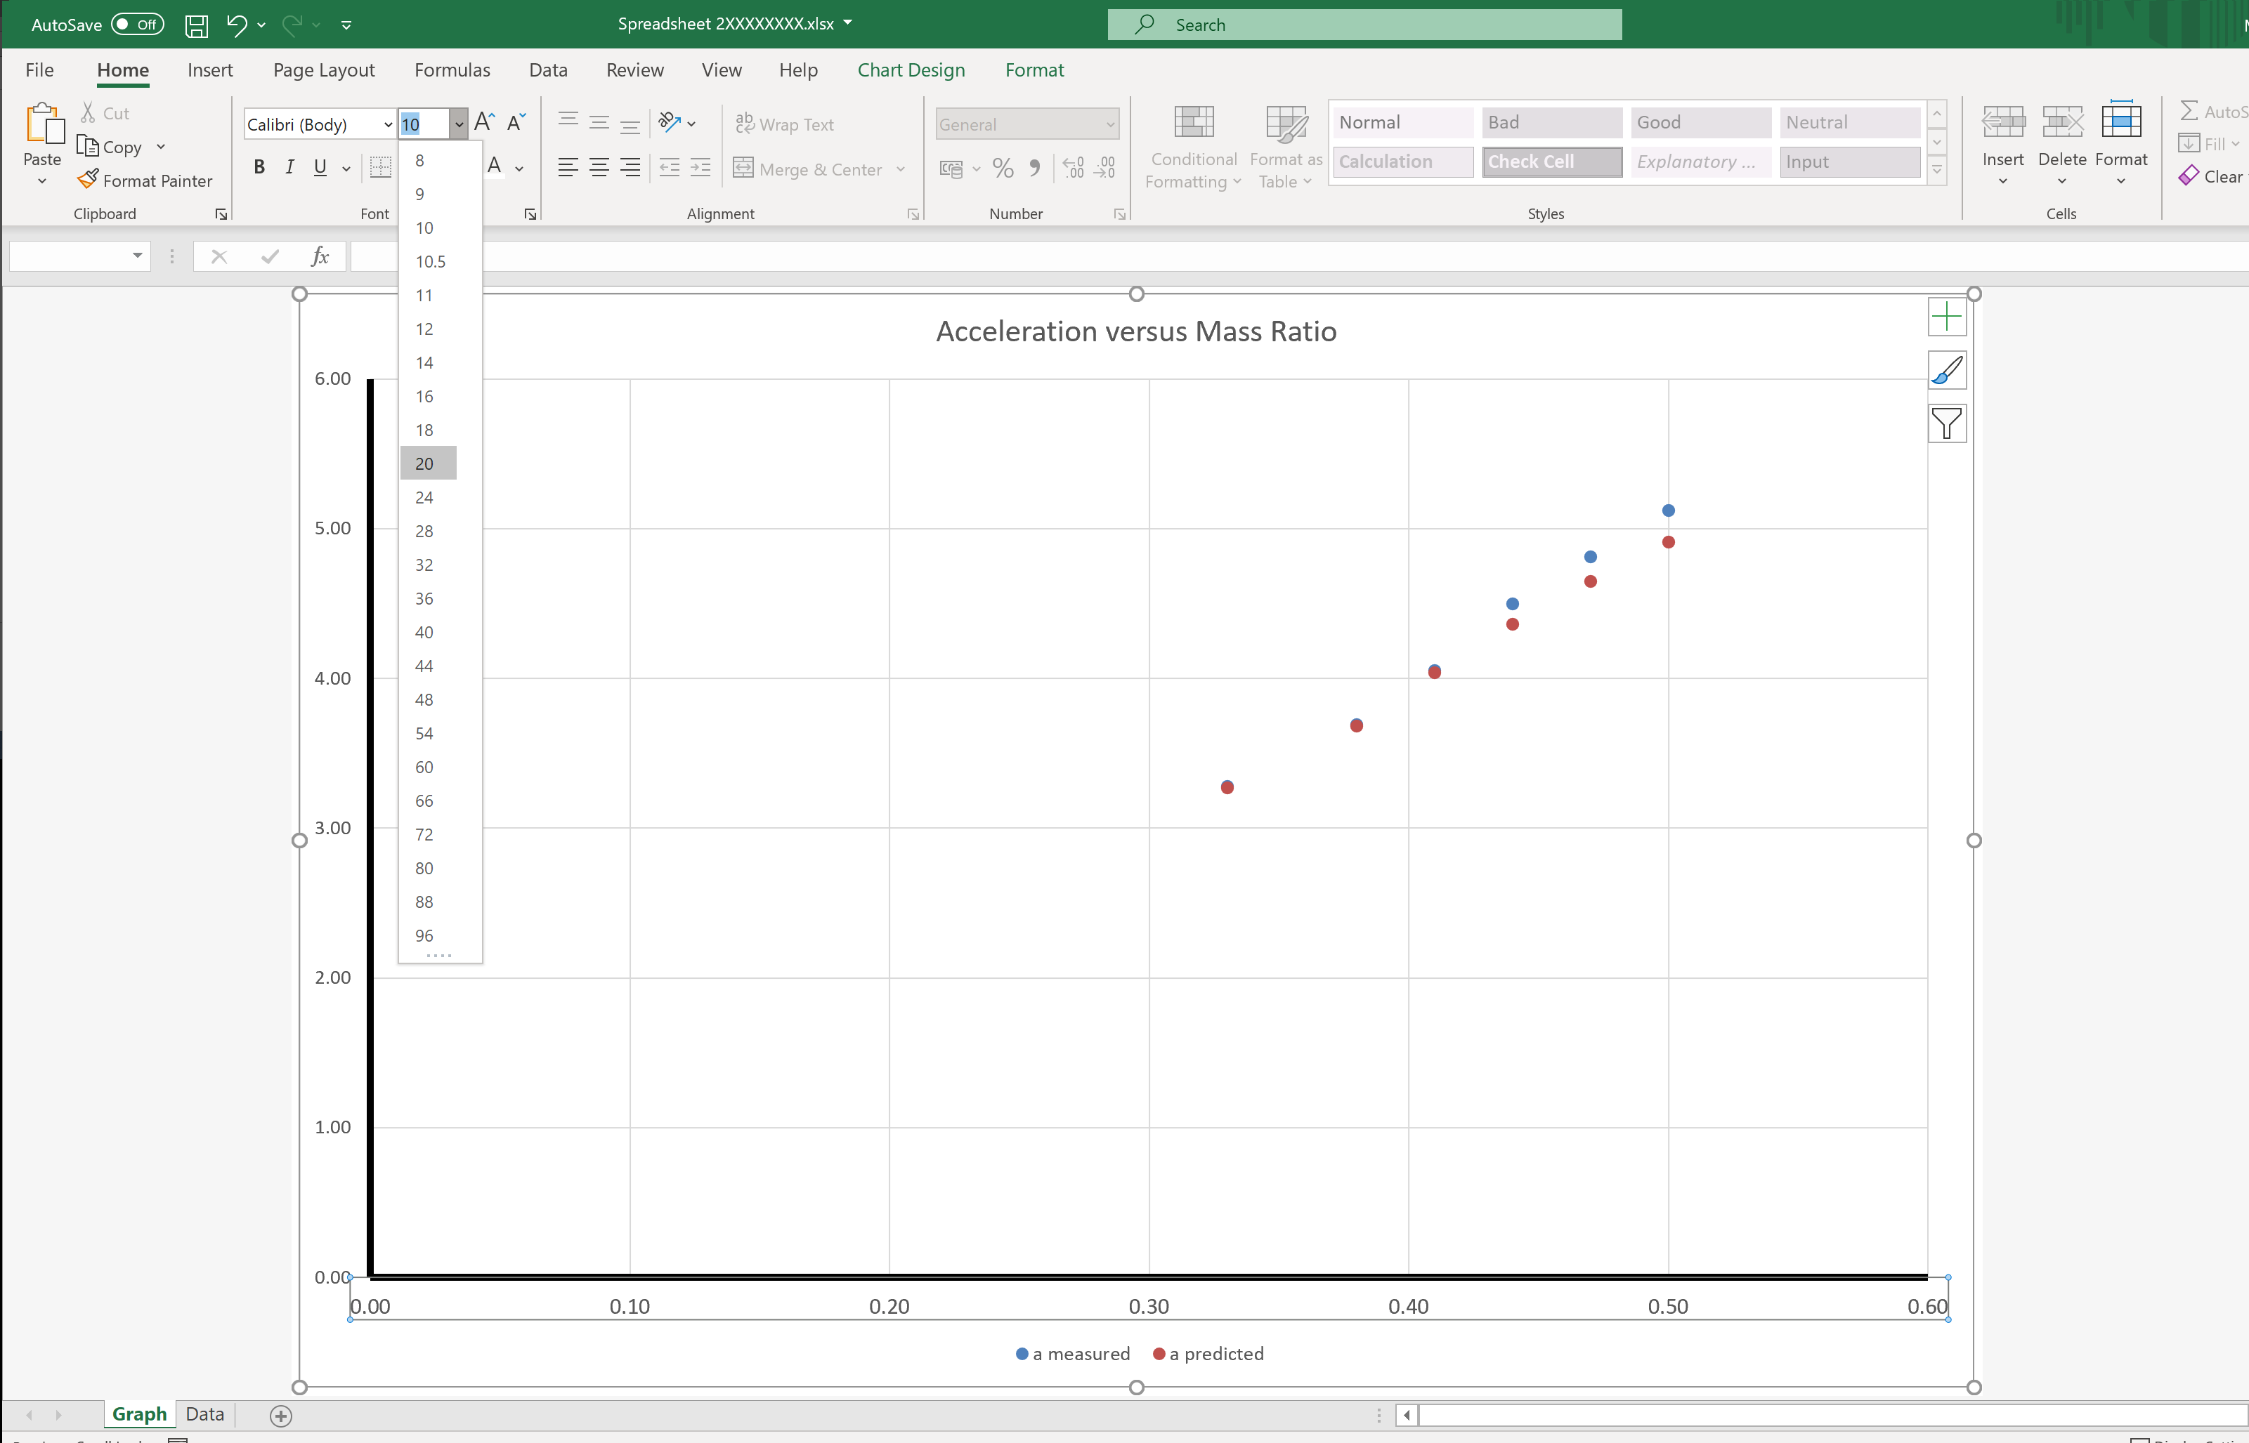
Left click on any number on x-axis, select the Home tab and adjust the font size to 20. Repeat for the y-axis.
Task One – Producing a Good Graph

Slide 22
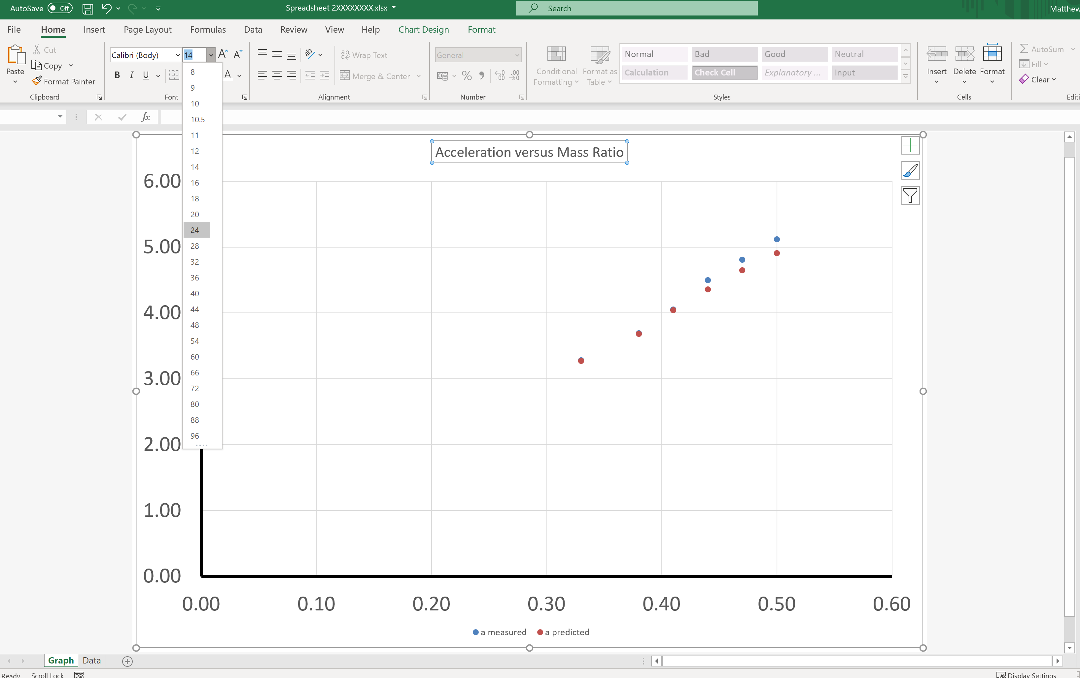
Left click on the graph title and set the font size to 24.
Task One – Producing a Good Graph

Slide 23
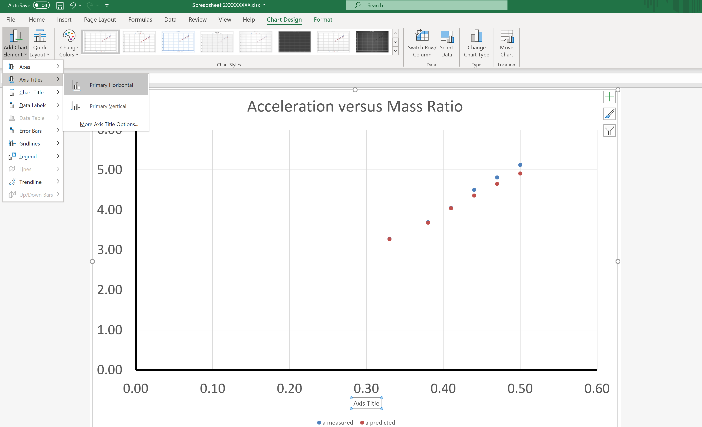
Click Chart Design > Add Chart Element > Axis Titles > Primary Horizontal
Task One – Producing a Good Graph

Slide 24
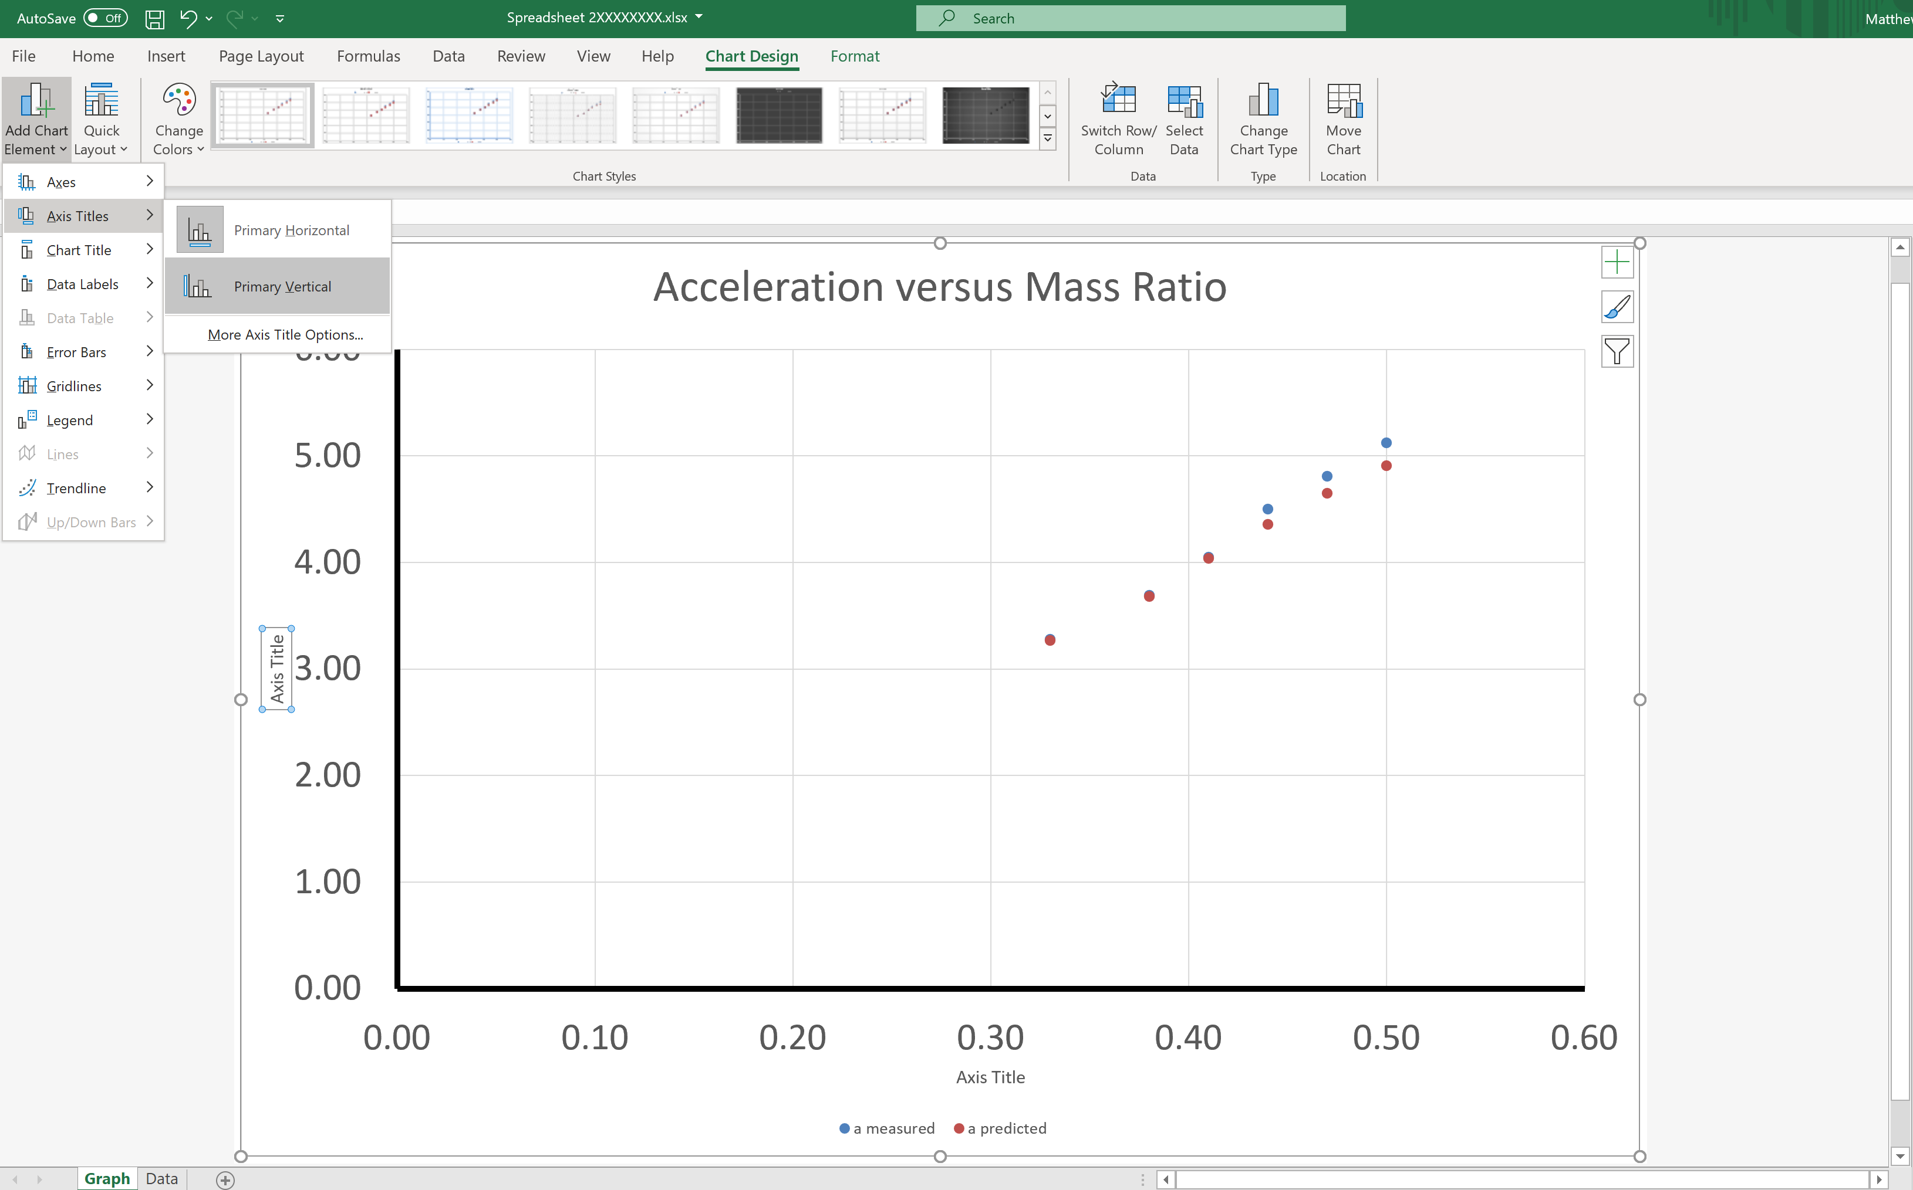
Click Chart Design > Add Chart Element > Axis Titles > Primary Vertical
Task One – Producing a Good Graph

Slide 25
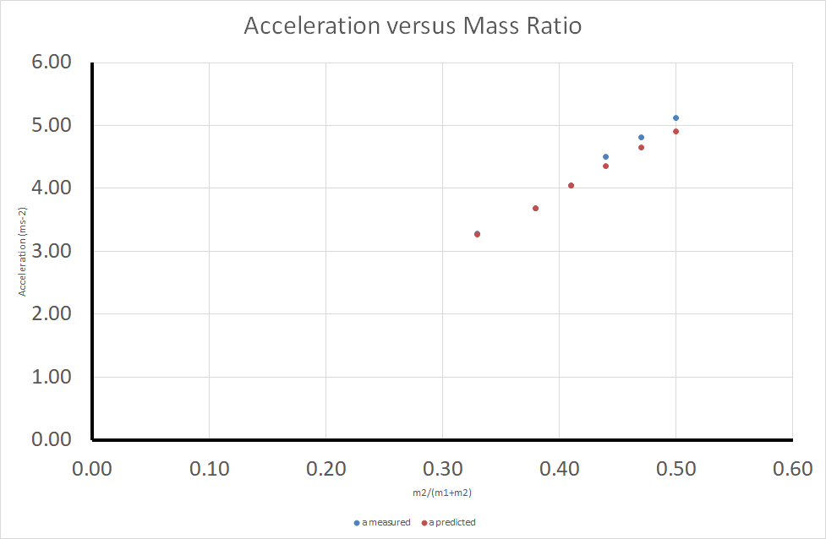
Copy and paste “m2/(m1+m2)” in to the x-axis title and “Acceleration (m∙s-2)” in to the y-axis title.
Task One – Producing a Good Graph

Slide 26
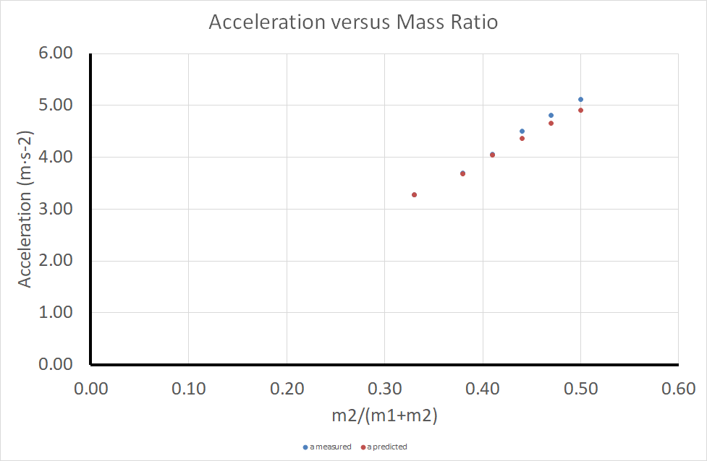
Left click on the x-axis title and increase the font size to 20. Do the same for the y-axis title. You may find you need to shrink the main graph at this point.
Task One – Producing a Good Graph

Slide 27
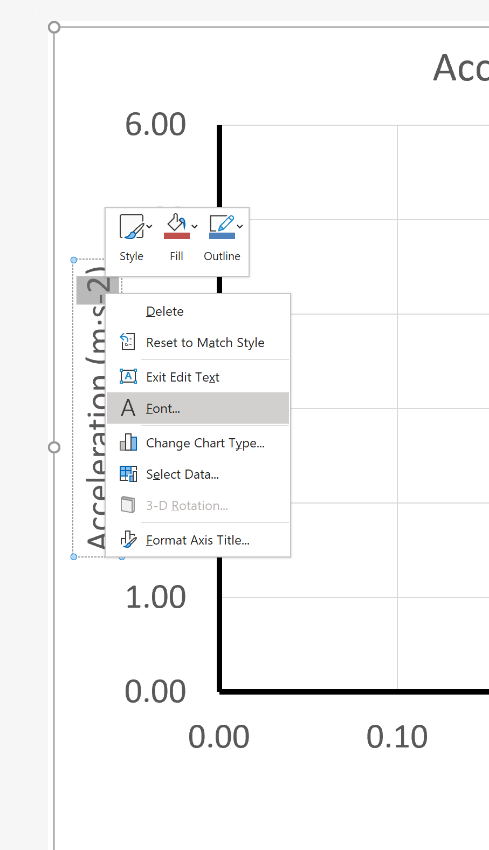
Highlight the “-2”, right click and select Font from the menu.
Task One – Producing a Good Graph

Slide 28
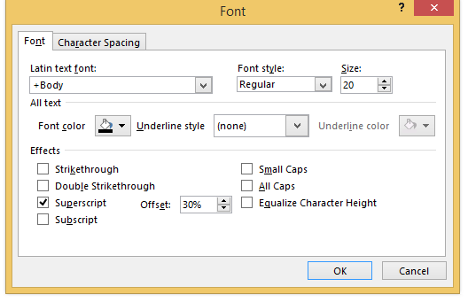
Select superscript from the option box and click OK.
Task One – Producing a Good Graph

Slide 29
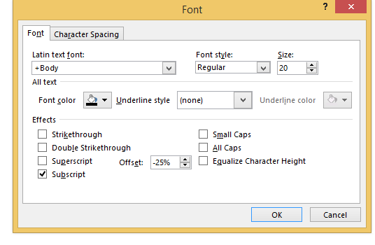
Now repeat this process for each of the numbers in the x-axis label. Except instead of superscript, click on subscript.
Task One – Producing a Good Graph

Slide 30

The graph should now look like this
Task One – Producing a Good Graph

Slide 31
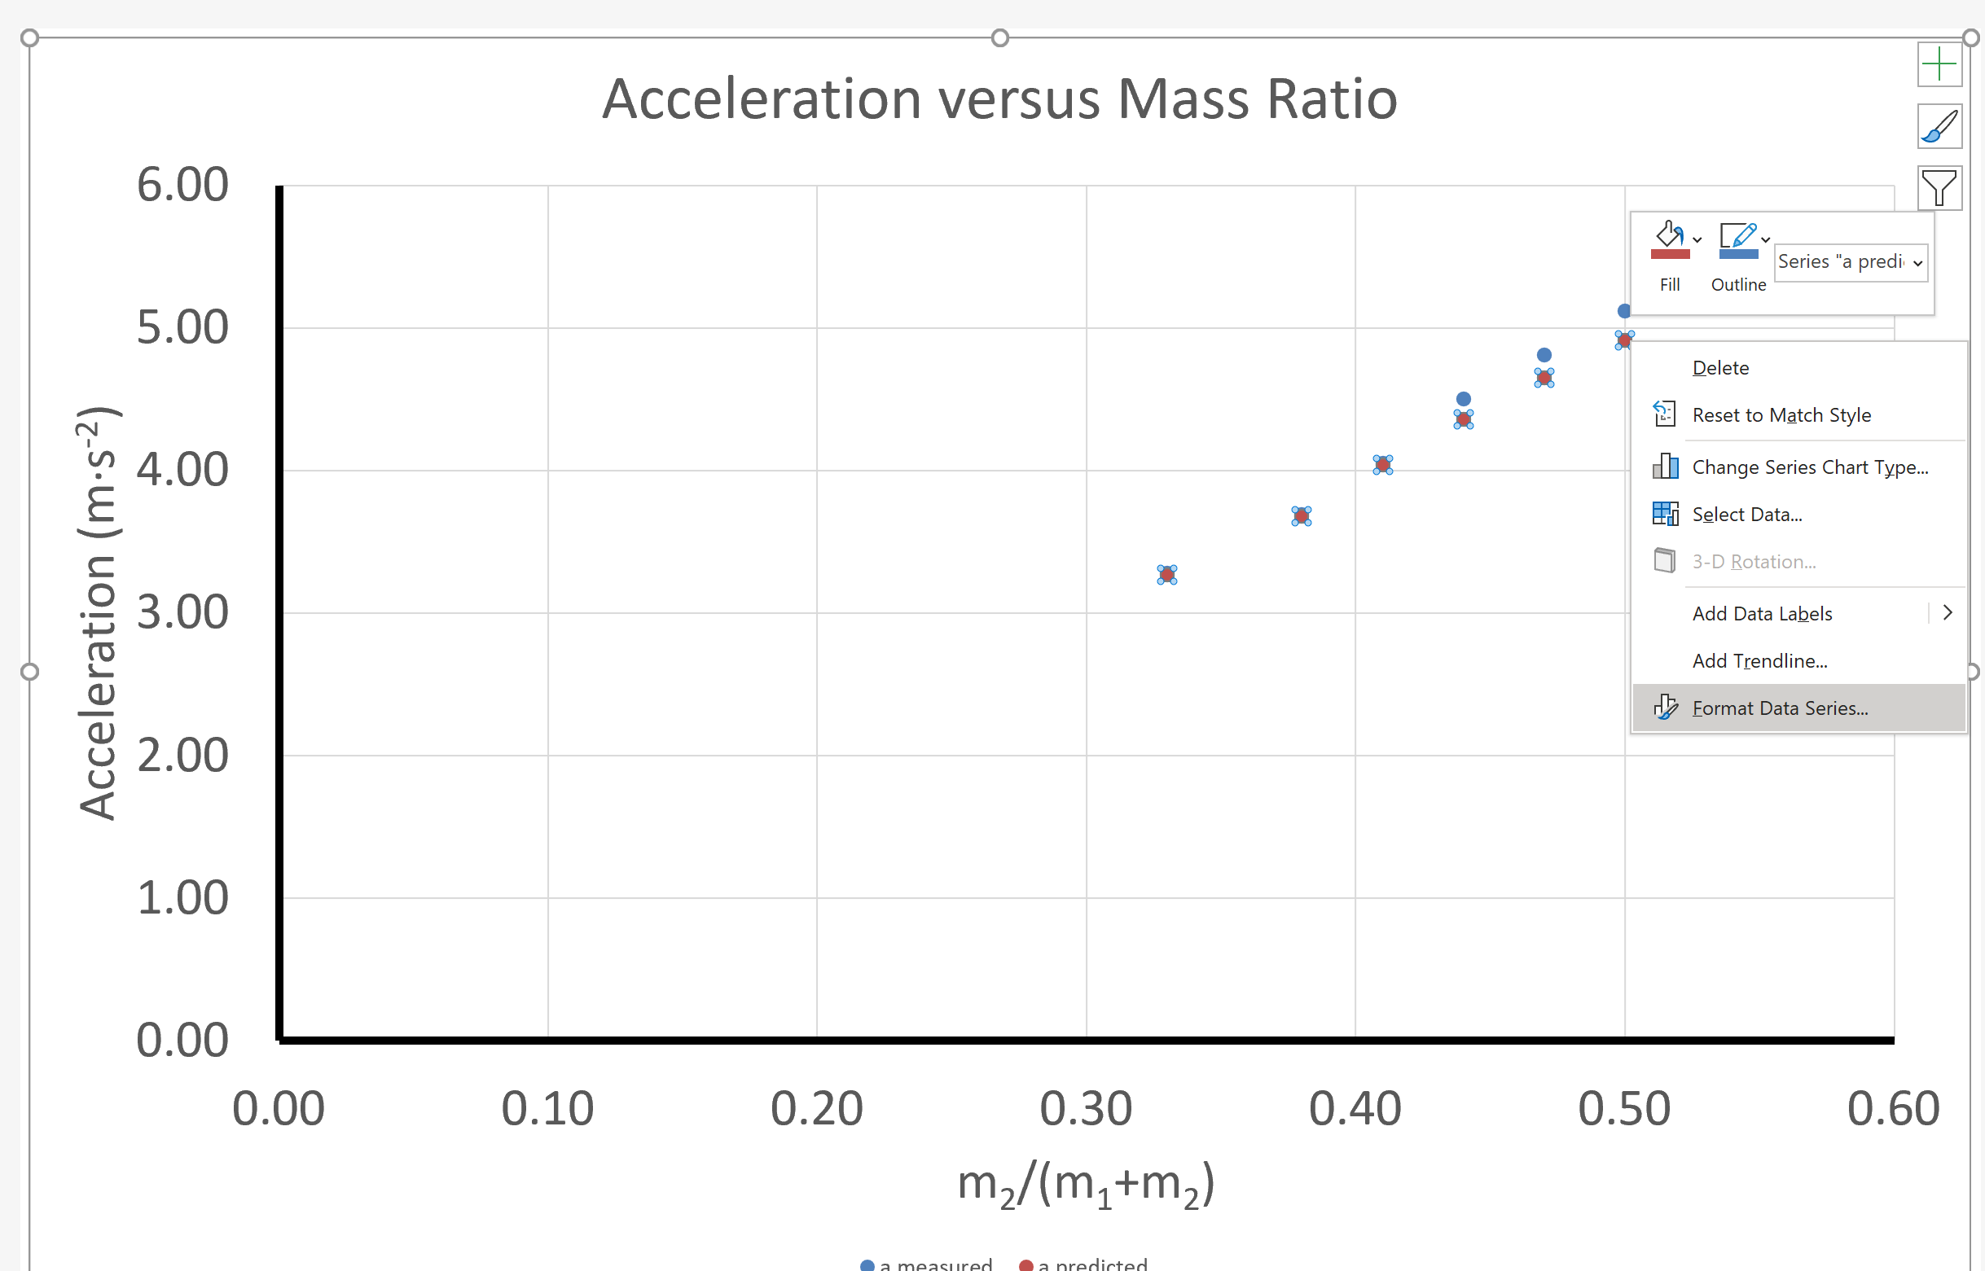
Click on one of the predicted values (red values), now right click and choose format data series from the menu.
Task One – Producing a Good Graph

Slide 32
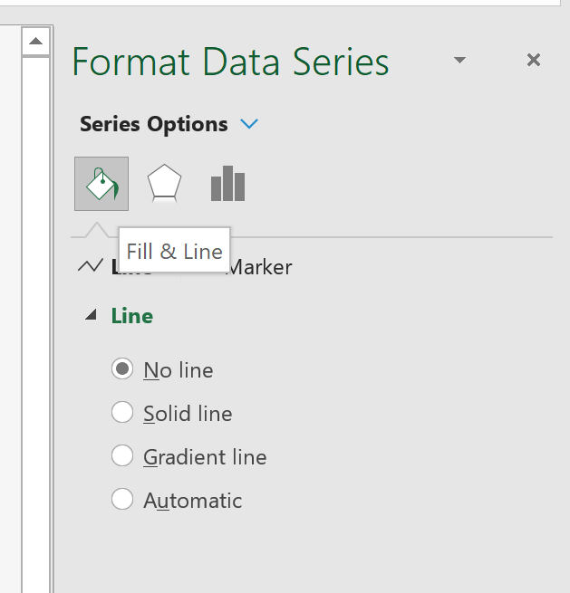
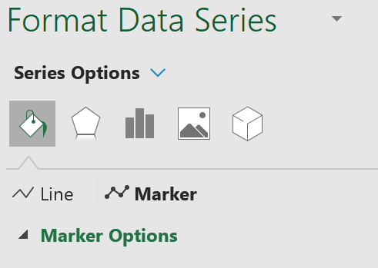
From the menu on the right side of the screen click on fill & line Then click on marker
Task One – Producing a Good Graph

Slide 33
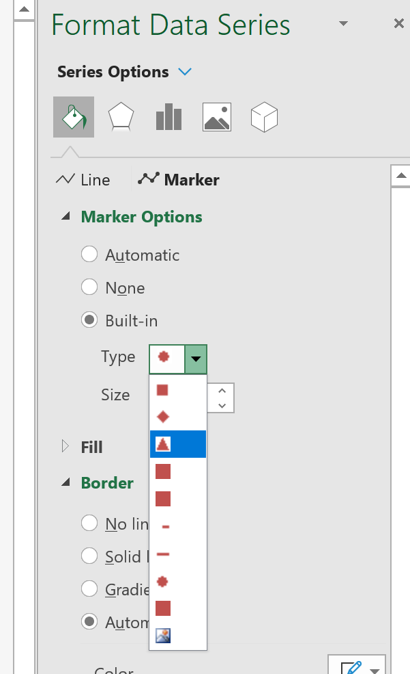
Next click on the marker options tab
Task One – Producing a Good Graph
Now choose the triangle symbol from the drop down menu

Slide 34
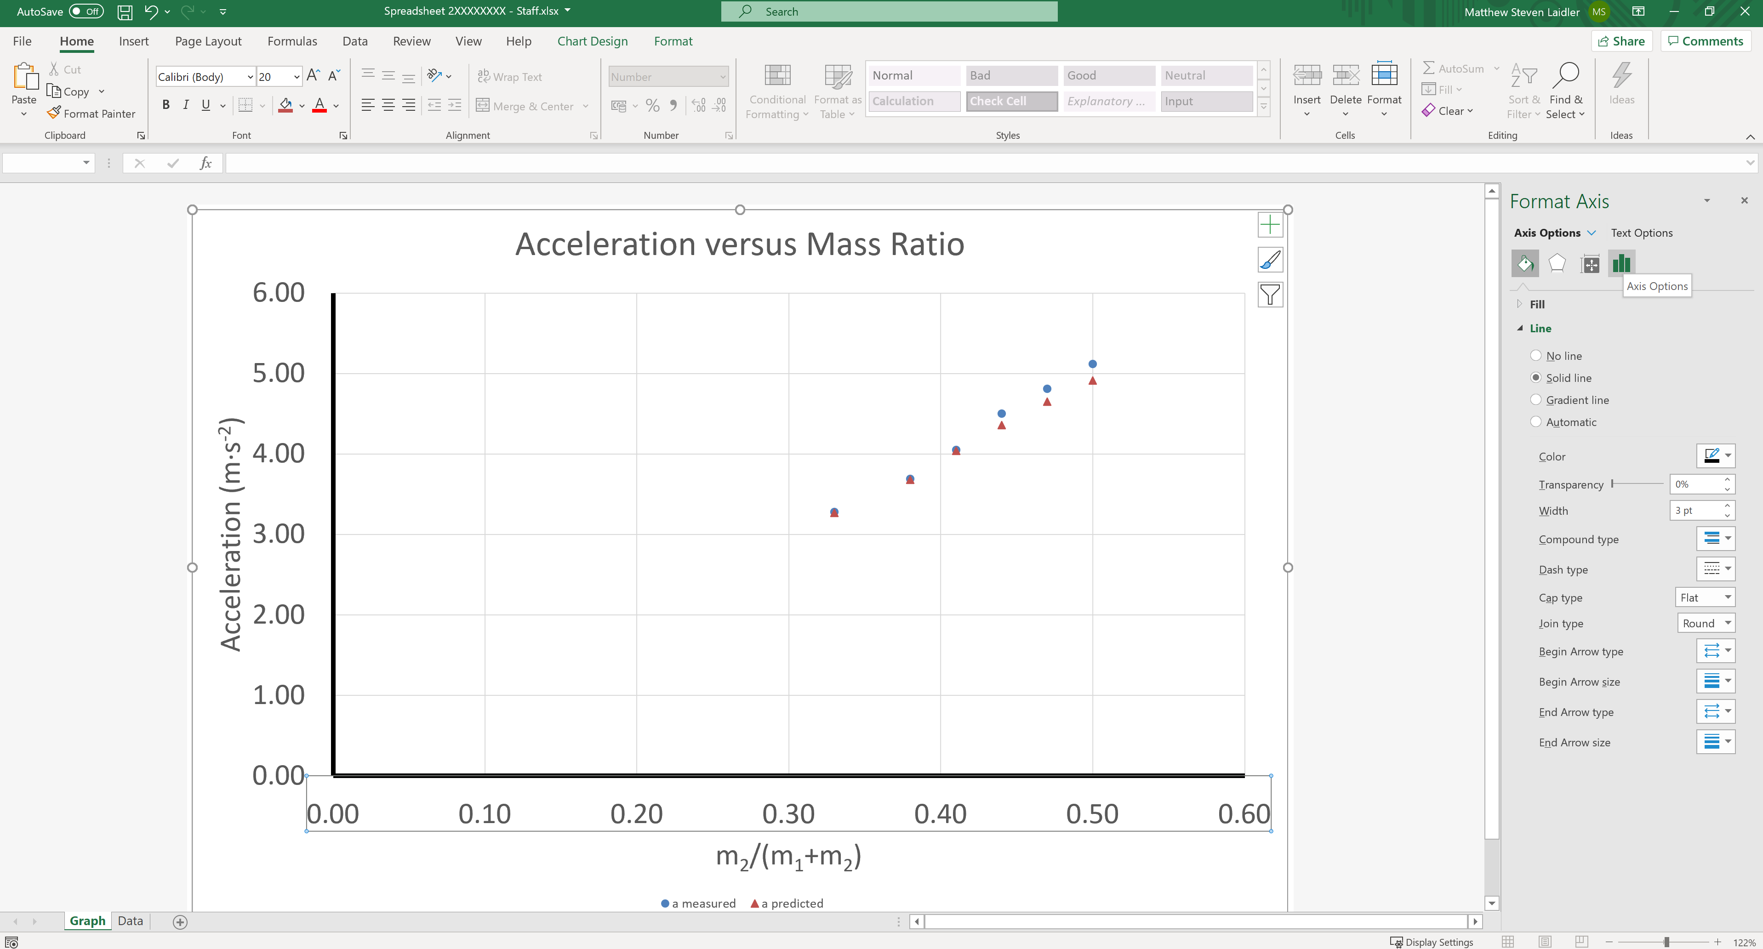
To finish off the graph, left click on the x-axis and choose Axis Options from the right hand menu.
Task One – Producing a Good Graph

Slide 35
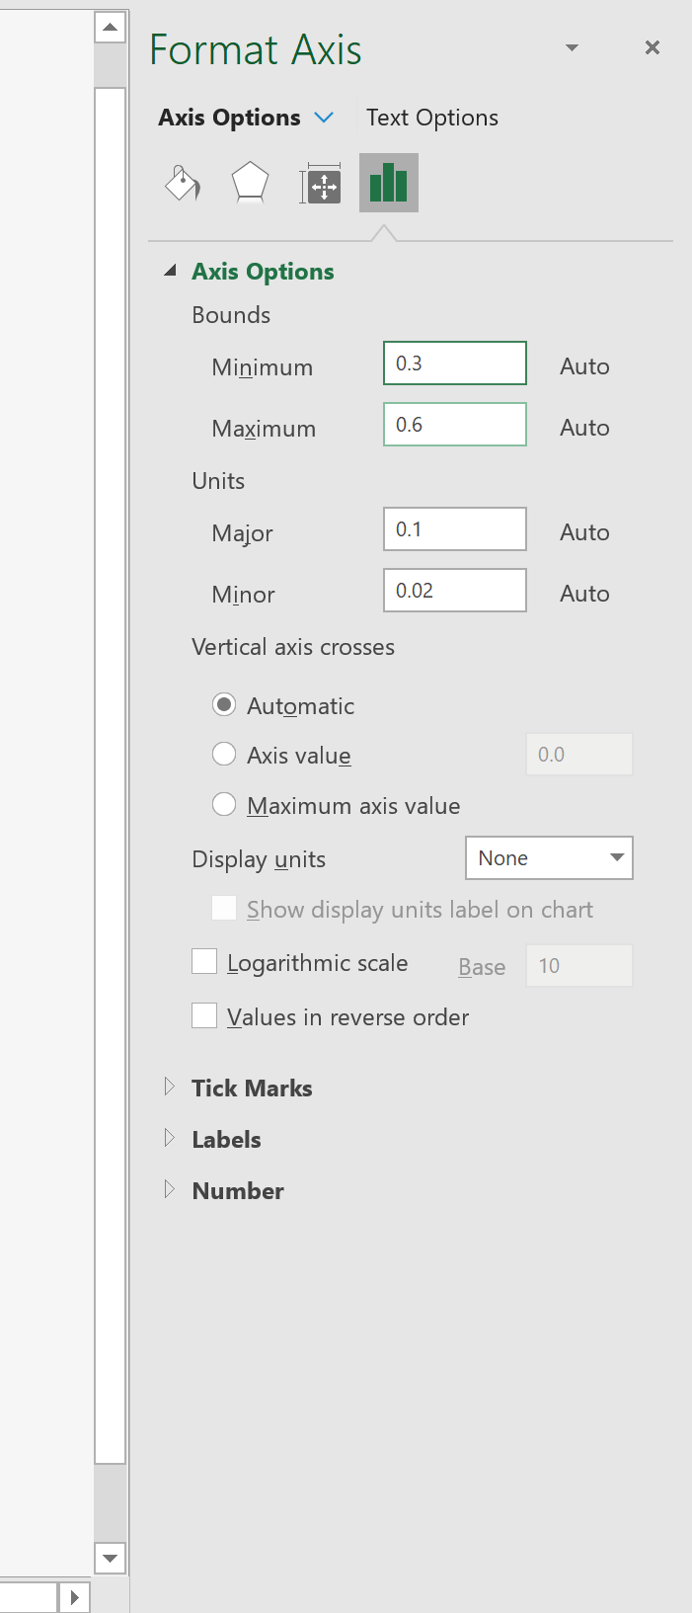
Set the Minimum Bound to 0.30
Task One – Producing a Good Graph

Slide 36
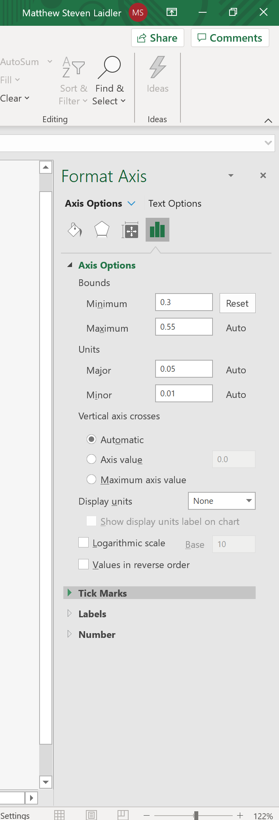
Now expand the Tick Marks menu
Task One – Producing a Good Graph

Slide 37
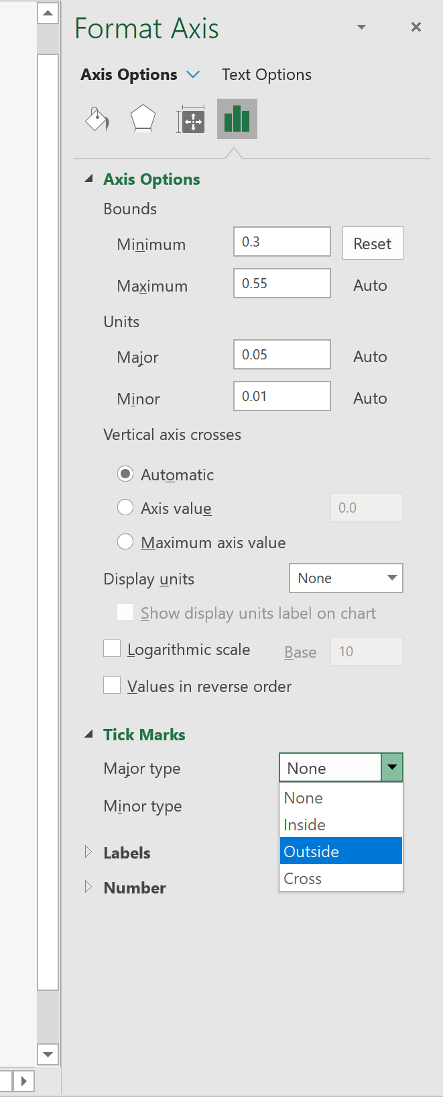
Set the Major Type to Outside
Task One – Producing a Good Graph

Slide 38
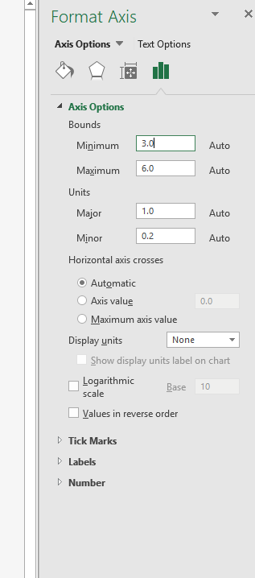
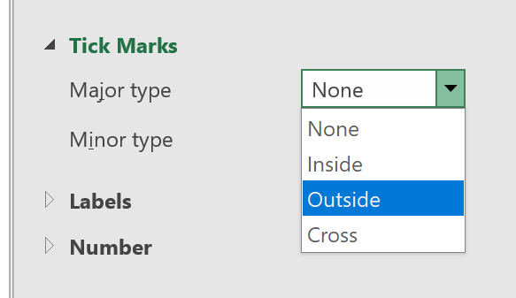
Repeat for the previous steps for the y-axis, set the Minimum Bound to 3.0 and add the Major Type Tick Marks to Outside
Task One – Producing a Good Graph

Slide 39
Task One – Producing a Good Graph
This completes the first task and your graph should look like the example below.

Slide 40

Good Graph Checklist
We have now covered the following areas
X
Title | Trendline
Data Spread | Equation and R²
Axis Labelled (including units) | Predicted and Measured Results
Appropriate Variables | Uncertainty “Error” Bars
X
X

Slide 41
Task 2
Representing Data with Excel:
Linear Trendlines

Slide 42
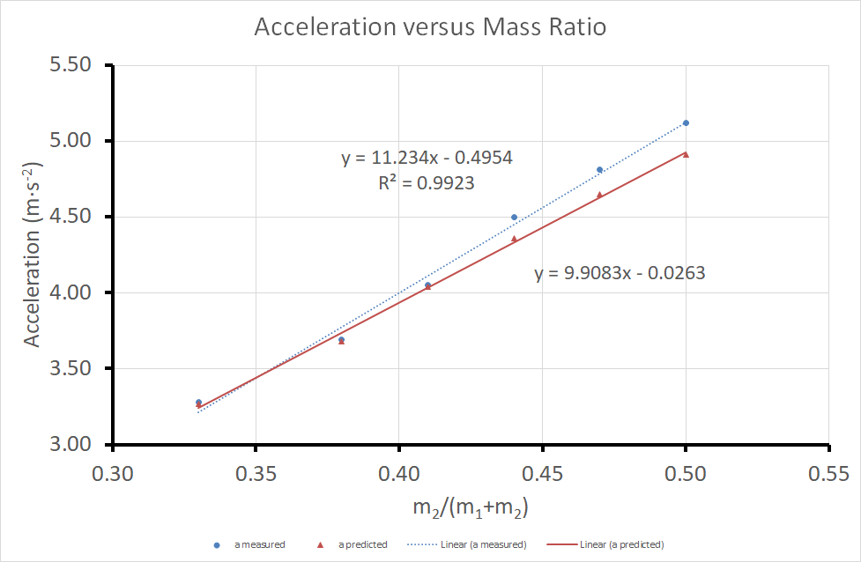
Task Two – Linear Trendlines
Lets add the trendlines (line of best fit) to the sets of data

Slide 43
Make sure your graph looks like the one below before you start to add the trendlines
Task Two – Linear Trendlines

Slide 44
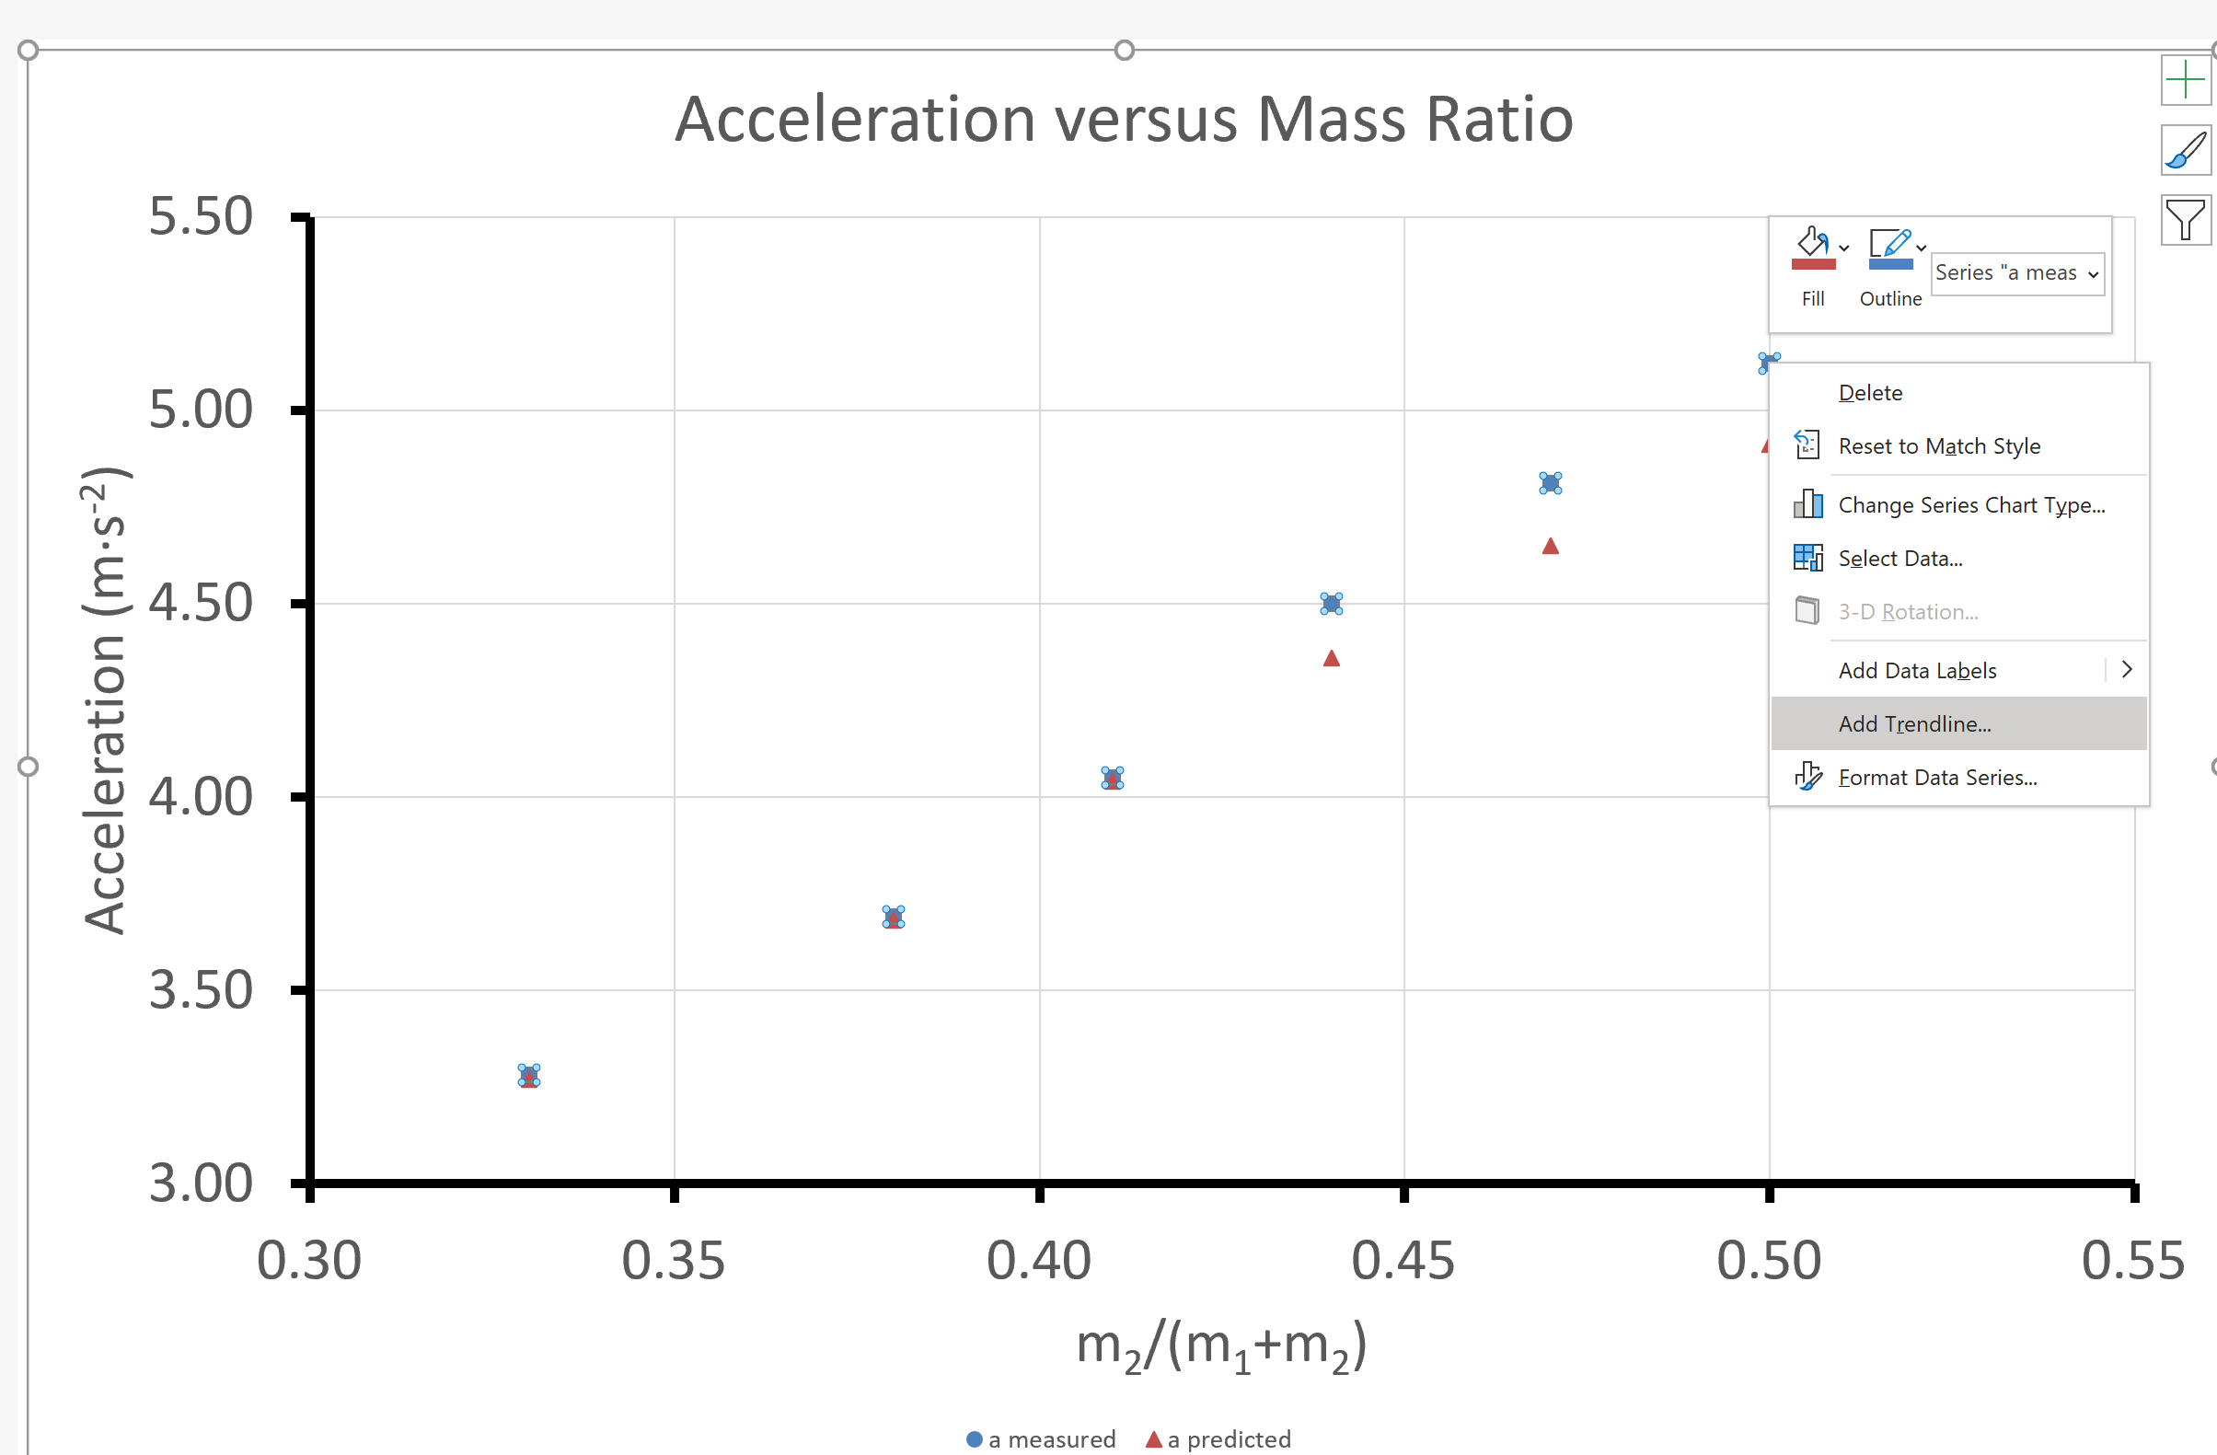
Right click over any data point from the measured data. From the menu select Add Trendline.
Task Two – Linear Trendlines

Slide 45
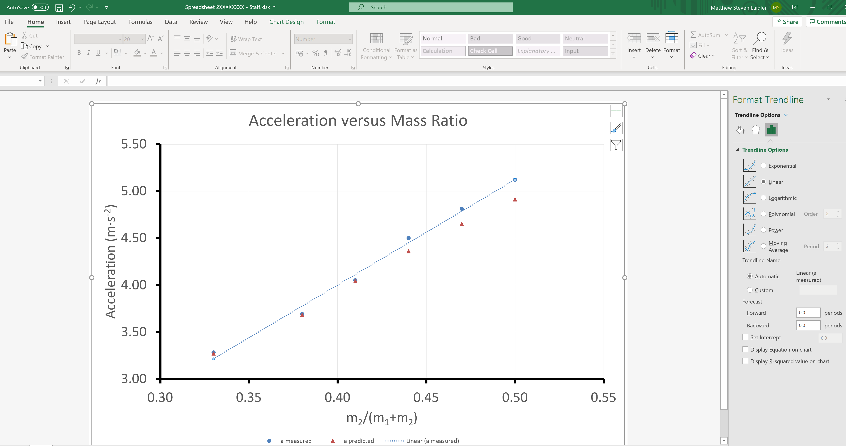
Select Linear from Trendline Options and select the “Display Equation on chart” & “Display R-squared value on chart”.
Task Two – Linear Trendlines

Slide 46
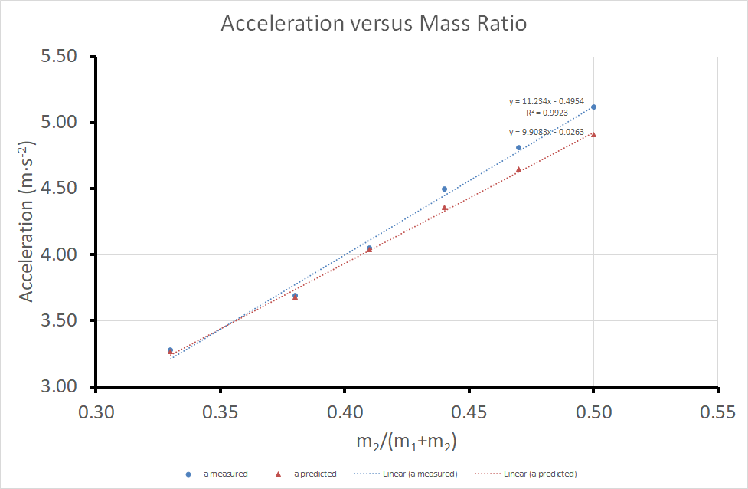
Now do the same for the predicted values (red data points). Note we don’t include R-squared for the predicted data set as it should be 1. Your graph should now look like this.
Task Two – Linear Trendlines

Slide 47
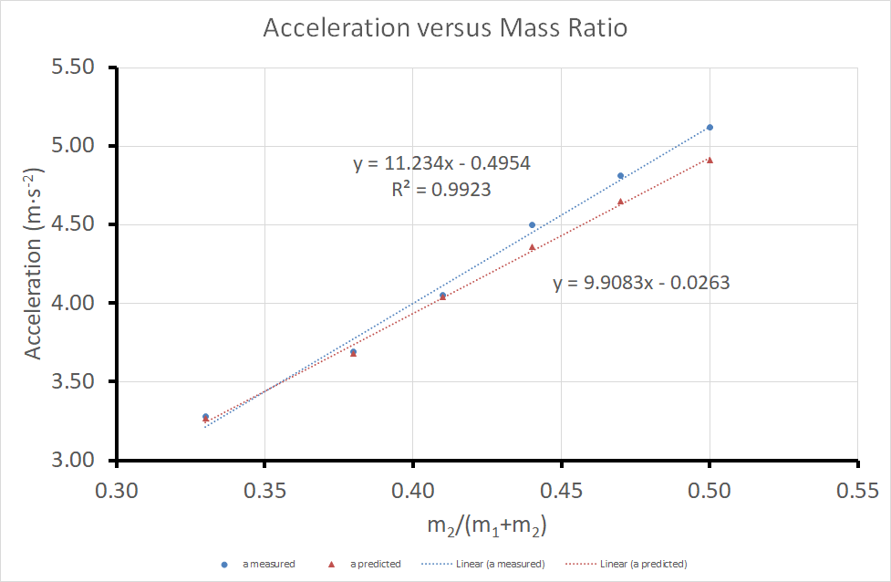
Next drag and drop the equations into the relevant region (see below) and increase the font size of the equations to 18.
Task Two – Linear Trendlines

Slide 48

Finally left click on the predicted (red) trendline and select “Fill & line”
Task Two – Linear Trendlines

Slide 49

From the drop-down menu choose solid line type
Task Two – Linear Trendlines

Slide 50
Task Two – Linear Trendlines
This completes task two.

Slide 51
Good Graph Checklist
When producing an experimental graph it is useful to consider the following checklist
We have now covered the following areas
Title | Trendline
Data Spread | Equation and R²
Axis Labelled (including units) | Predicted and Measured Results
Appropriate Variables | Uncertainty “Error” Bars
X

Slide 52
Task 3
Representing Data with Excel:
Uncertainty Bars

Slide 53
Let’s add the uncertainty bars (also referred to as “error bars” in the excel).
Task Three – Uncertainty Bars

Slide 54
Make sure your graph looks like the one below for you to start this task
Task Three – Uncertainty Bars

Slide 55

Left click on the a-measured data set. In the toolbar click Chart Design > Add Chart Element > Error Bars> More error Bars Options.
Task Three – Uncertainty Bars

Slide 56

Left click and then right click the x-error bars, and choose the delete option from the menu
Task Three – Uncertainty Bars

Slide 57

Left click on the y error bars, and select Error Bar Options from the righthand menu
Task Three – Uncertainty Bars

Slide 58

Click Custom, and then click on the Specify Value to give a new window: Custom Error Bars
Task Three – Uncertainty Bars

Slide 59

Task Three – Uncertainty Bars
Click on the arrow of the Positive Error Value on the new window

Slide 60

Go to the Data sheet, and highlight the standard uncertainty δa_{m}
Task Three – Uncertainty Bars

Slide 61

After you select the data the “Custom Error Bars” window should look like this
Task Three – Uncertainty Bars
Now click on the arrow again

Slide 62
Click on the arrow of the Negative Error Bars on the new window and repeat the process, again choosing the values under δa_{m}
Task Three – Uncertainty Bars

Slide 63

Go back to the Custom Error Bars window and click OK.
Task Three – Uncertainty Bars

Slide 64

The graph should now look like this:
Task Three – Uncertainty Bars

Slide 65

Now repeat the same process with the predicted data. When choosing the values to use for the error bars you should choose the following for the positive and negative values.
Task Three – Uncertainty Bars

Slide 66

The graph is now finished and can be used for analysis purposes.
Task Three – Uncertainty Bars

Slide 67
Good Graph Checklist
When producing an experimental graph it is useful to consider the following checklist
Title | Trendline
Data Spread | Equation and R²
Axis Labelled (including units) | Predicted and Measured Results
Appropriate Variables | Uncertainty “Error” Bars
So far we have covered how to produce a graph with all of these elements above.

Slide 68
Task 4
Representing Data with Excel:
Uncertainty in Trendlines
🤔 Recall what are the dependent and independent of the experiment? Are they in simple linear form in your mathematical model? If not, what have we done to make sure these are linear?

Slide 69

Task Four – Uncertainty in Trendlines
Download “Uncertainty in Trendlines” file from Moodle.
🙂 The correct way to use this table, is to enter your independent in column ‘x’, dependent in ‘y’, and their uncertainties in ‘δx’ and ‘δy’ respectively.
Results will be calculated automatically on the right.
Open the file and it should look like the above. Please note you can only edit the cells within the borders.

Slide 70

Task Four – Uncertainty in Trendlines
Next highlight and copy the x-values from the table or results.
Only copy the numbers, not the title!

Slide 71

Task Four – Uncertainty in Trendlines
It is a good idea to use the paste values function when copying number between Microsoft Excel sheets.
After copying some data go to where you want to paste it and right click and choose paste values

Slide 72

Task Four – Uncertainty in Trendlines
Next paste them in to the Uncertainty in Trendlines spreadsheet.

Slide 73

Task Four – Uncertainty in Trendlines
Repeat the process for the y-values ($a_{m}$).

Slide 74

Task Four – Uncertainty in Trendlines
Your spreadsheet should now look like this.

Slide 75


Task Four – Uncertainty in Trendlines
Repeat the process for the x uncertainty values ($δm_{2}/(m_{1}+m_{2})$)

Slide 76


Task Four – Uncertainty in Trendlines
Repeat the process for the y uncertainty values ($δa_{m}$)

Slide 77

Task Four – Uncertainty in Trendlines
Your spreadsheet should now look like this.

Slide 78



Task Four – Uncertainty in Trendlines
This spreadsheet has now given us the intercept, gradient, $r$ and $R^{2}$ of the best straight line fit, alongside the uncertainties associated with each.
Gradient
$m=11.2±2.95$
Intercept
$$c=−0.50±1.2$$
$$r=0.996$$
$$R^{2}=0.992$$

Slide 79


Task Four – Uncertainty in Trendlines
Complete the table in your original excel spreadsheet by inputting the uncertainties for the measured and predicted trendlines.
You will need to repeat the previous steps using the values for predicted acceleration, $a_{p}$, and the uncertainty for predicted acceleration, ${δa}_{p}$.

Slide 80
Task 5
Representing Data with Excel:
Drawing a Conclusion

Slide 81

Task Five – Drawing a Conclusion
Finally complete the last task by comparing your measured and predicted results and drawing a conclusion (fill in the last part of the table).

Slide 82





Task Five – Drawing a Conclusion
For two values to agree they need to have possible values in common when we consider the uncertainty.
For example
The predicted value, $x_{p}$, agrees with the measured value, $x_{m}$, since there are values they have in common when we consider the uncertainty.
Value
Uncertainty
$$x_{m}=20.8±0.2$$
$$x_{p}=20.7±0.4$$
$$20.6≤x_{m}≤21.0$$
$$20.3≤x_{p}≤21.1$$

Slide 83
This is the end of this workshop.
Thank you for your attention!

